Slide 1


LIFO vs. FIFO

Slide 2

Emerging Trends in Inventory Management

Slide 3
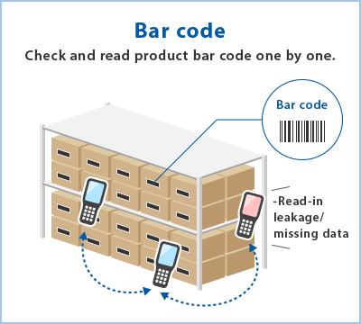
Emerging Trends in Inventory Management
Automation:
Inventory Tracking and Management can be improved by integrating robotics to get real-time updates. Robots can be equipped with RFID and sensors to scan and identify each time, update the inventory records and optimize storage. This increases inventory levels accuracy in real time and reduces opportunities of human error

Slide 4
Emerging Trends in Inventory Management
Demand Forecasting and Inventory planning using Data Analytics and Insights
Inventory planning is a process that involves balancing supply and demand, managing inventory levels and optimizing order fulfillment.
Data analytics and insights can be used to accurately forecast demand and determine ideal inventory levels for each product by understanding patterns and trends in the existing data.
Businesses can improve forecasting and save costs on storage by applying Data Analytics in Inventory planning.

Slide 5
Emerging Trends in Inventory Management
Dynamic Pricing through Machine Learning
Dynamic pricing is the practice of setting a price for a product or service based on current market conditions.
Traditionally, sellers used to set the price based on a manual analysis of the cost, demand, supply or competition. This was limited to premium pricing (higher than the market) and penetration pricing (relatively lower than the market).
Through machine learning, the dynamic approach ensures scalability of the pricing decisions. Dynamic pricing algorithms also bring flexibility as retailers can set prices targeting different groups of shoppers. This can be achieved by creating an optimal value offering based on market trends, demand fluctuations, customer behavior, purchasing power, and plenty of other factors.

Slide 6
Future of LIFO and FIFO
Germany has adapted

Slide 7
Sources:
https://www.technology-innovators.com/warehouse-robotics-automation-and-efficiency-in-inventory-management/
https://conjura.com/how-to-leverage-data-analytics-to-forecast-stock-and-demand-a-guide-for-inventory-planners/
https://www.mightycube.co.jp/en/solution/inventry-management/
https://medium.com/total-data-science/how-machine-learning-is-helping-in-providing-dynamic-pricing-7efdb8af9083
https://www.ifrs.org/use-around-the-world/use-of-ifrs-standards-by-jurisdiction/view-jurisdiction/germany/#:~:text=Germany%20has%20already%20adopted%20IFRS,international%20accounting%20standards%20(IAS).

Slide 8

Python implementation

Slide 9
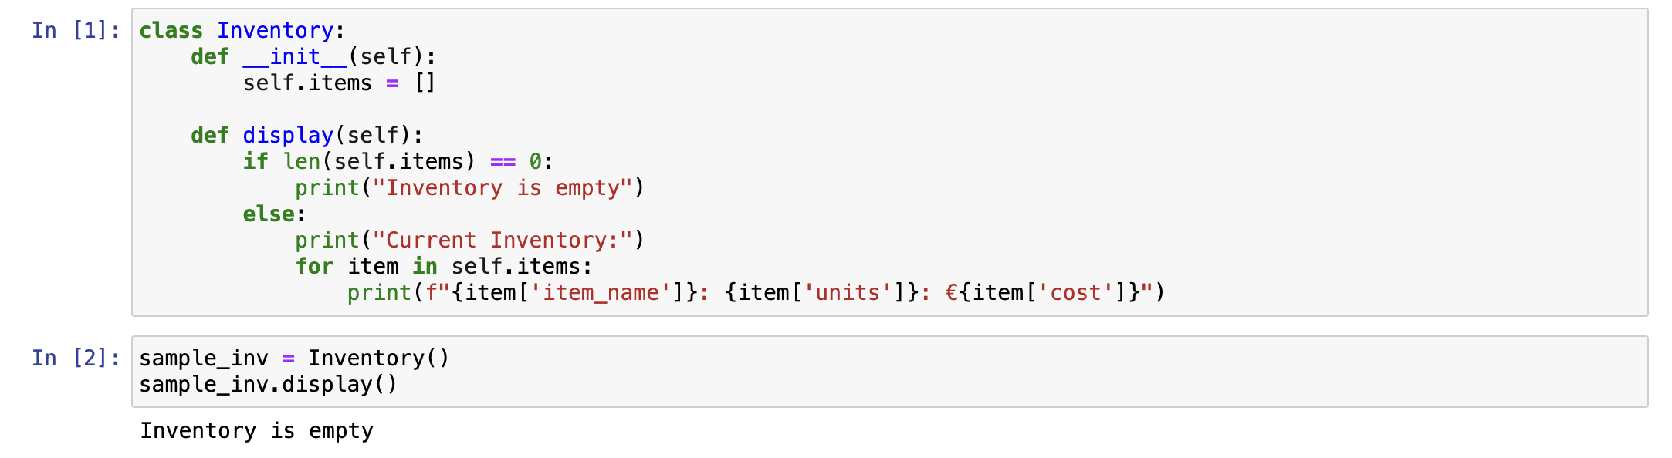
Creating an inventory in python
Using object-oriented programming, we created a Class of Inventory with a display function.

Slide 10
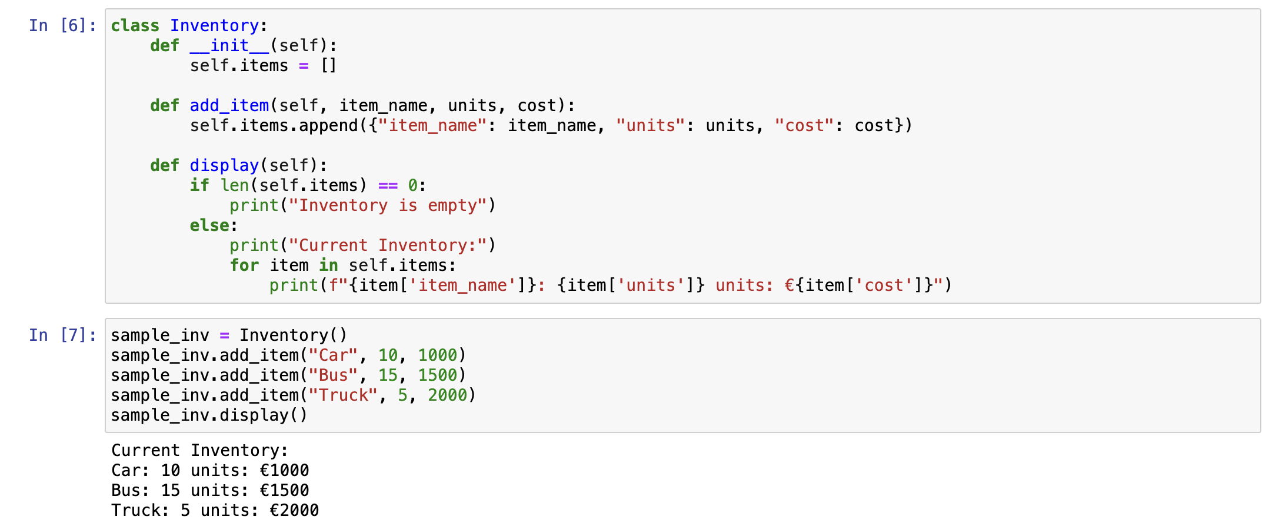
Creating an inventory in python
Created the add_item function within our class, we added items to the end of the list with name, number of units and cost of each unit

Slide 11
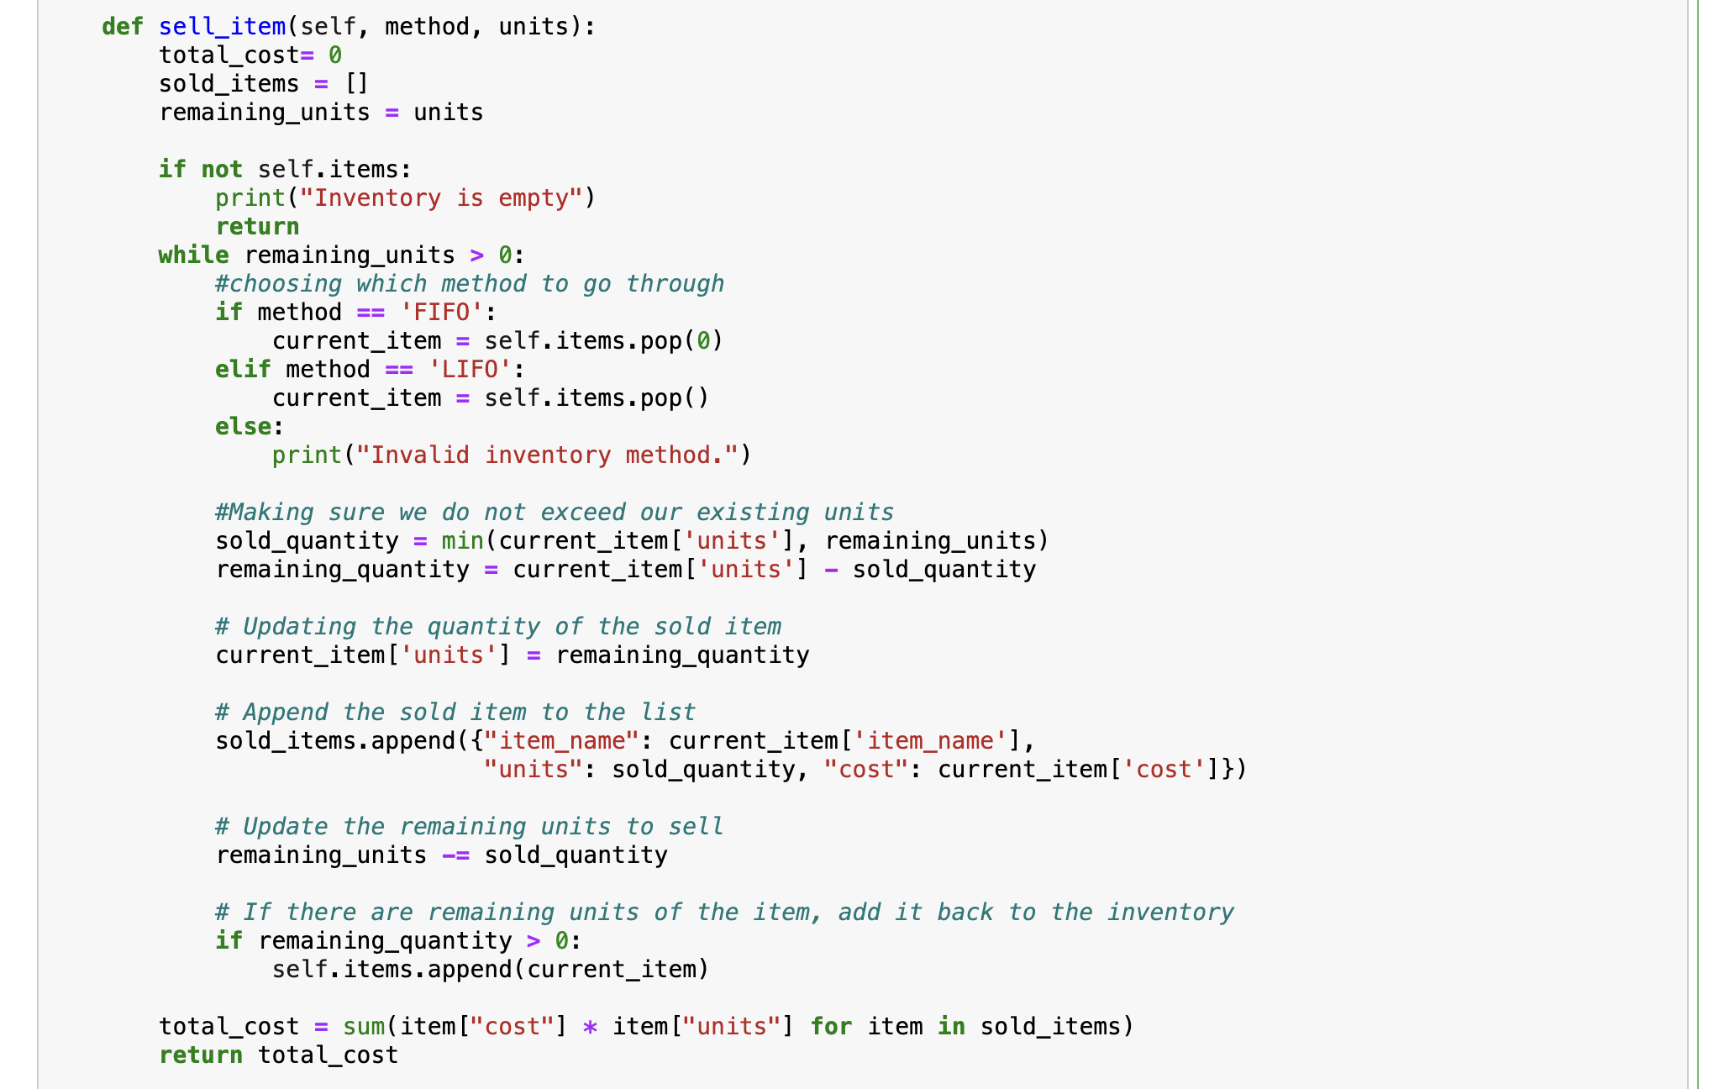
Applying LIFO and FIFO in python
We add a sell_items function for which we needed the method – where we implement FIFO or LIFO.

Slide 12
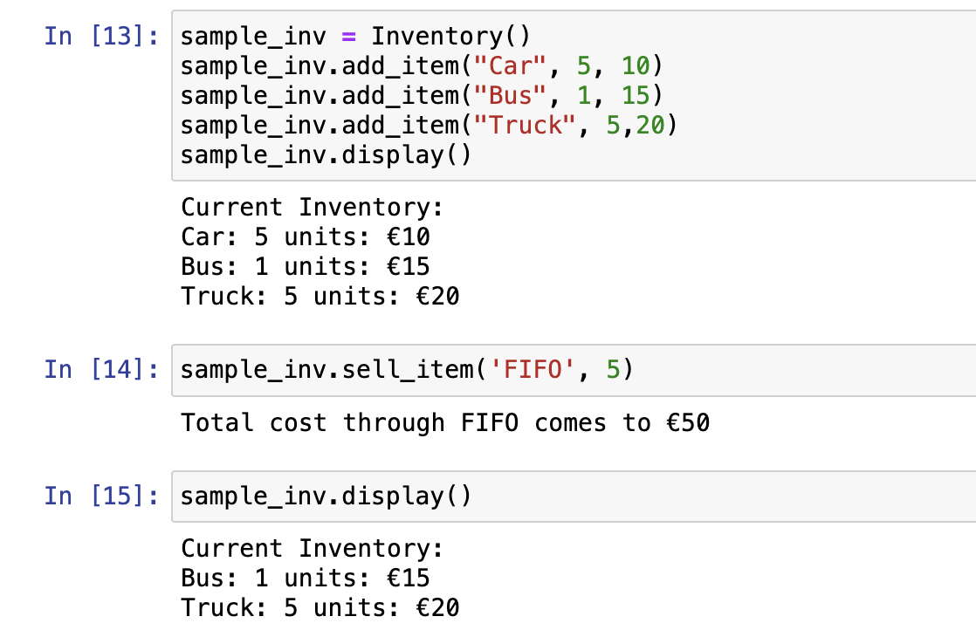
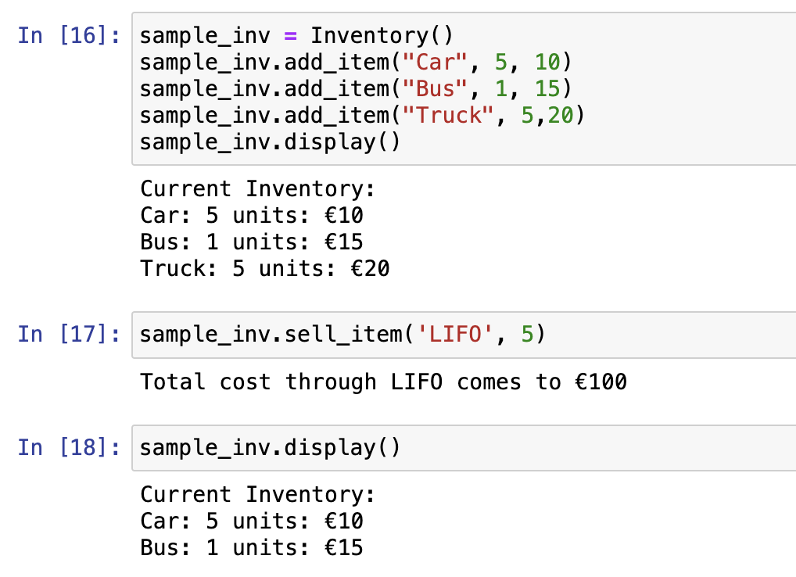
Applying LIFO and FIFO in python
FIFO:
LIFO

